Slide 1
HRM DATABASE DESIGN
Designed by | Huy Nguyen
Last updated | 03-July-2015

Slide 2
Contents
Conceptual Model
Logical Model
Mock up
Physical Model

Slide 3

Conceptual Model

Slide 4
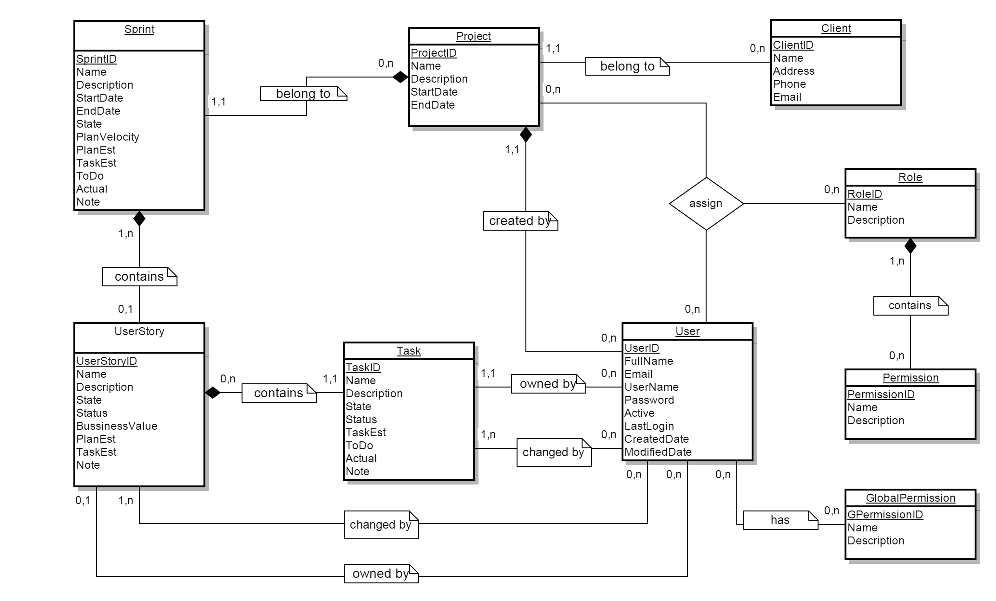
Conceptual Model

Slide 5
Logical Model

Slide 6
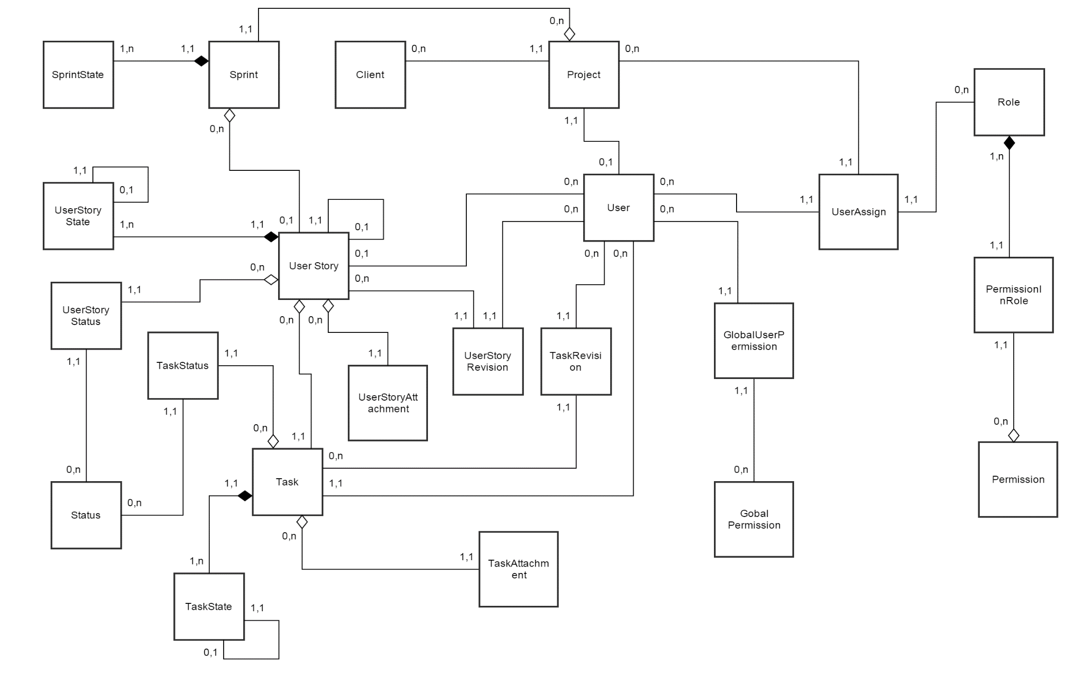
Logical Model

Slide 7
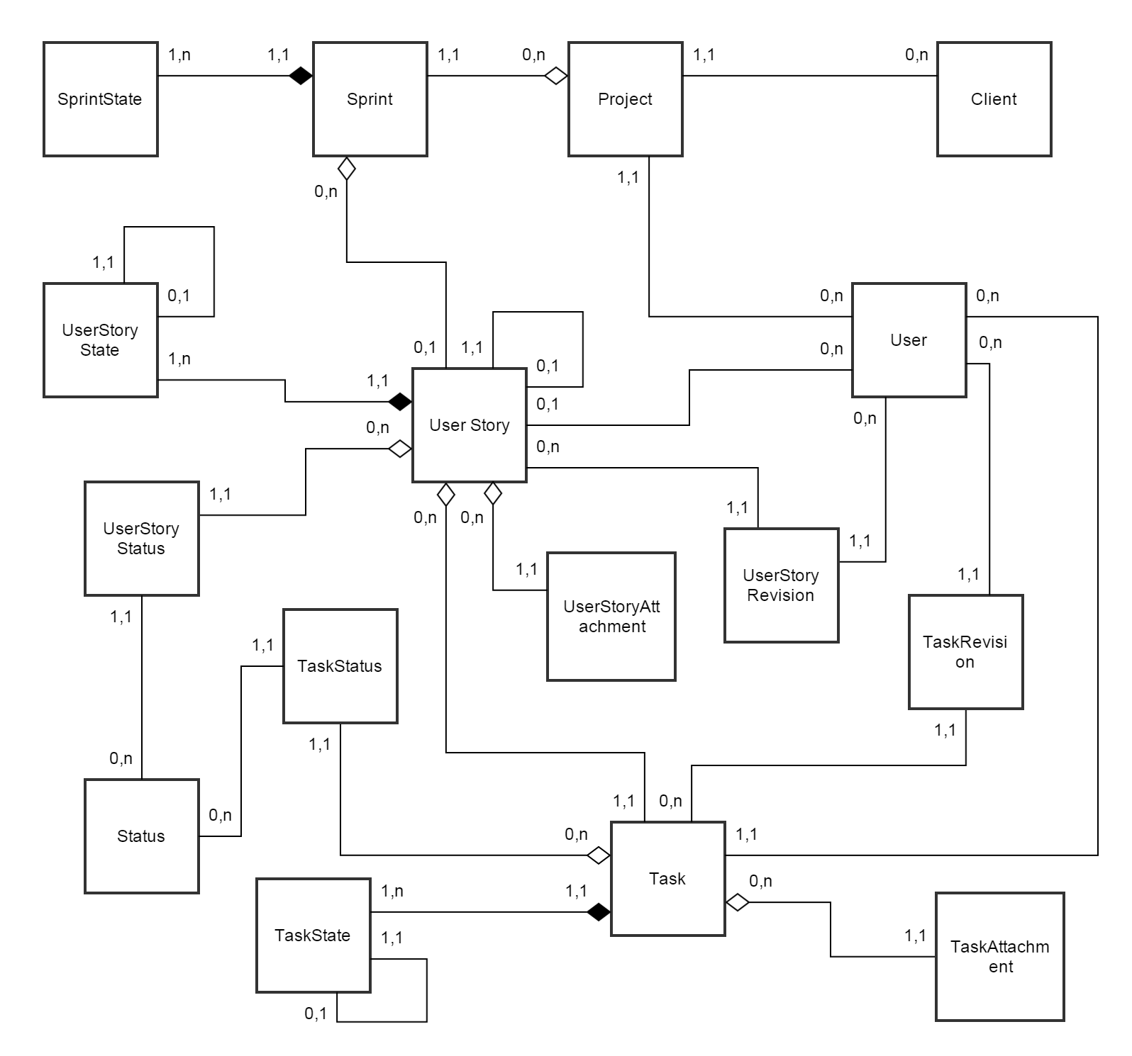
Logical Model
Project Management

Slide 8
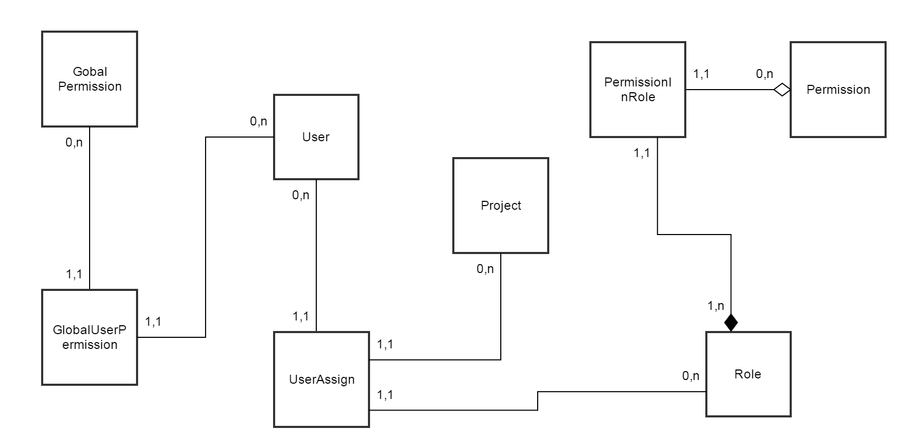
Logical Model
User Management

Slide 9
Mock up

Slide 10
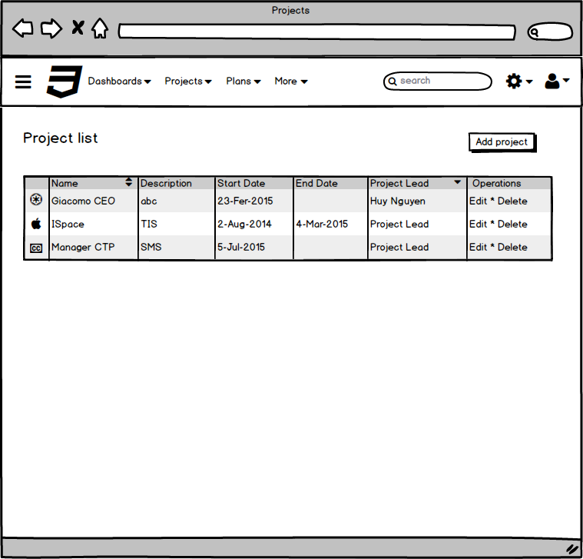
“Project List” screen

Slide 11
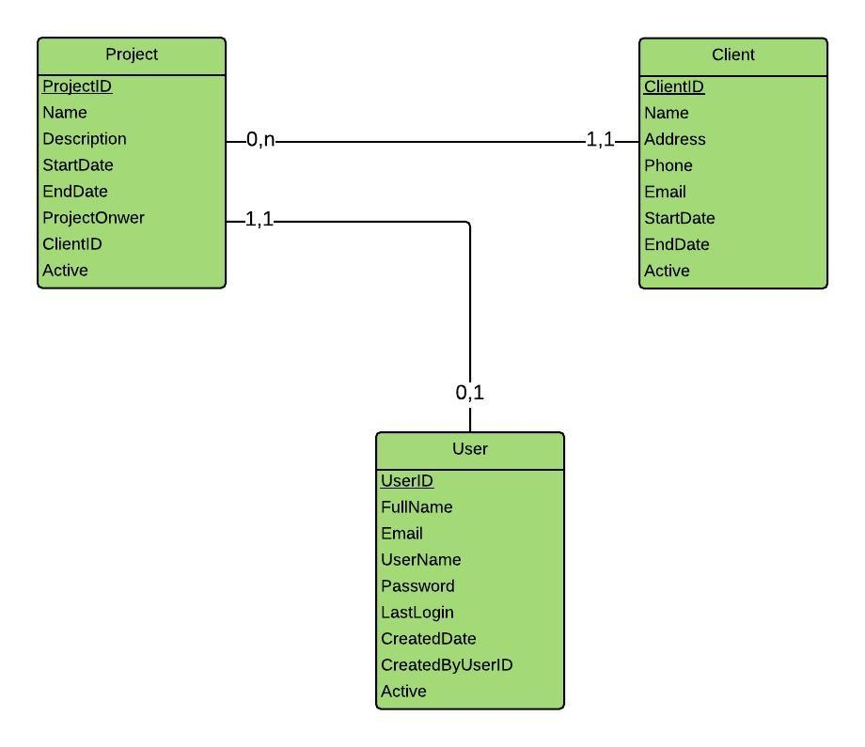
“Project List” screen

Slide 12
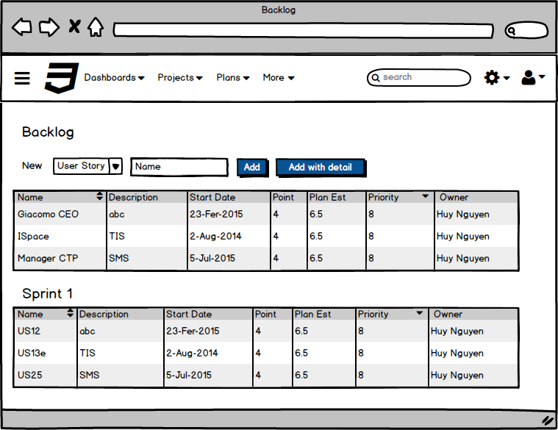
“Backlog” screen

Slide 13
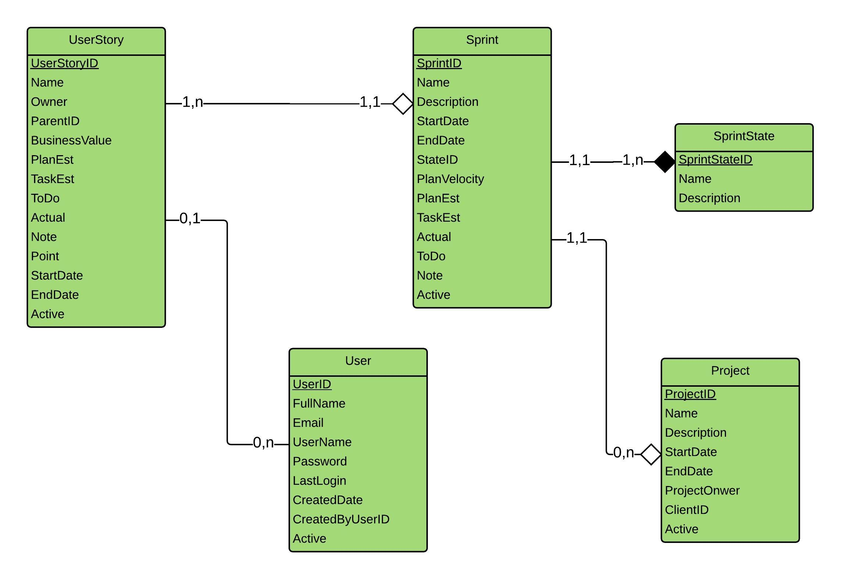
“Backlog” screen
Notes:
SWAT 2010

Slide 14
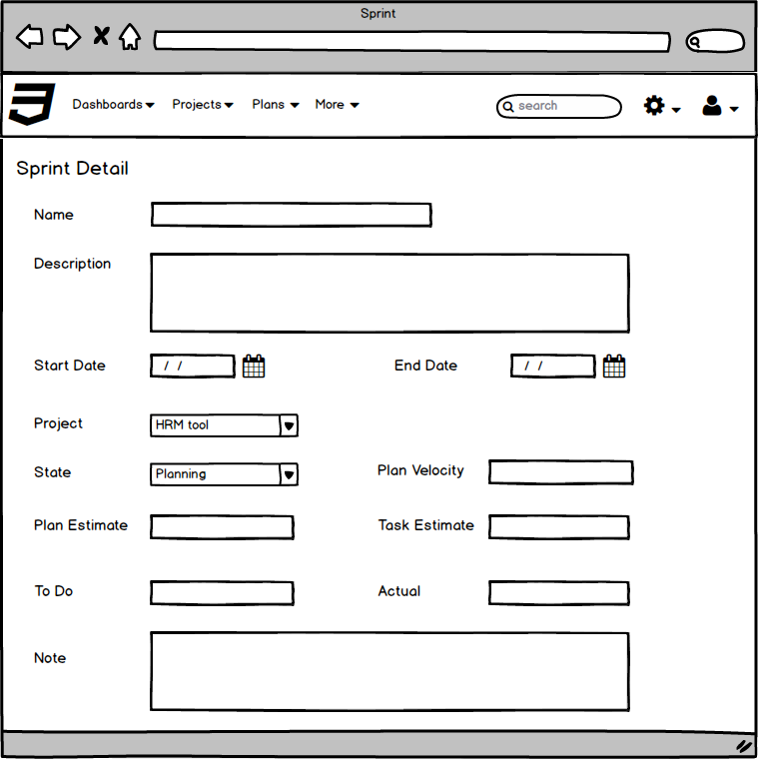
“Sprint Detail” screen

Slide 15
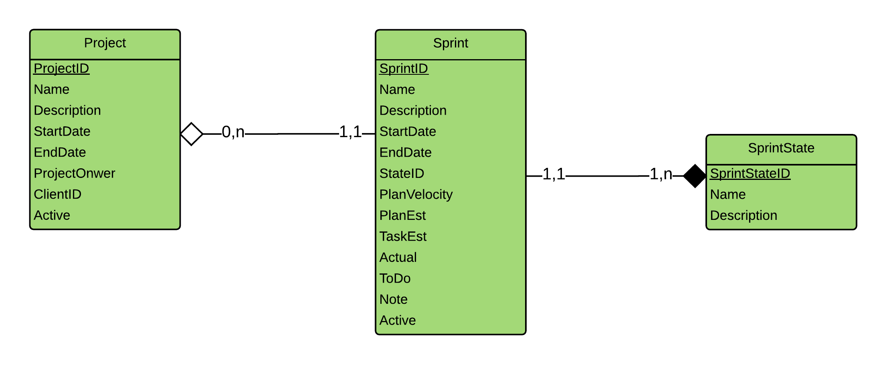
“Sprint Detail” screen

Slide 16
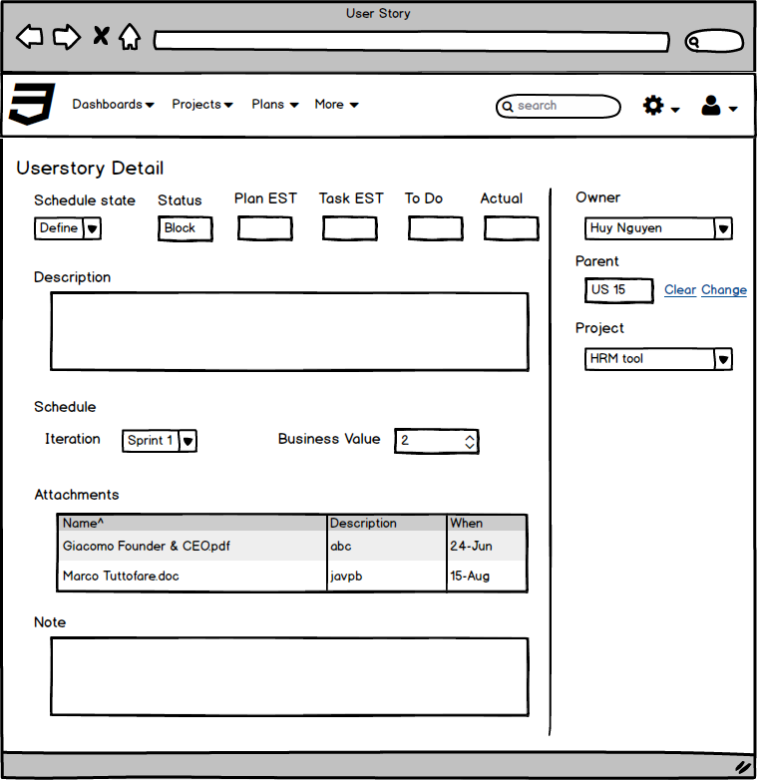
“User Story Detail” screen

Slide 17
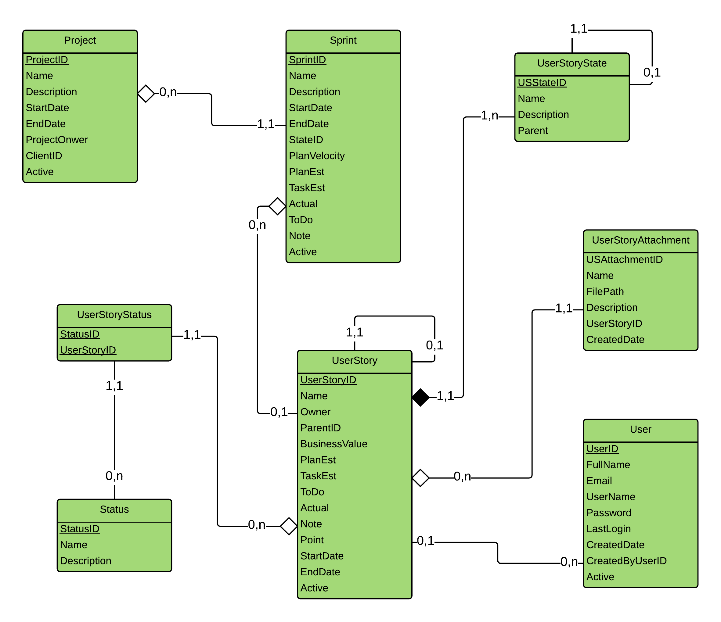
“User Story Detail” screen

Slide 18
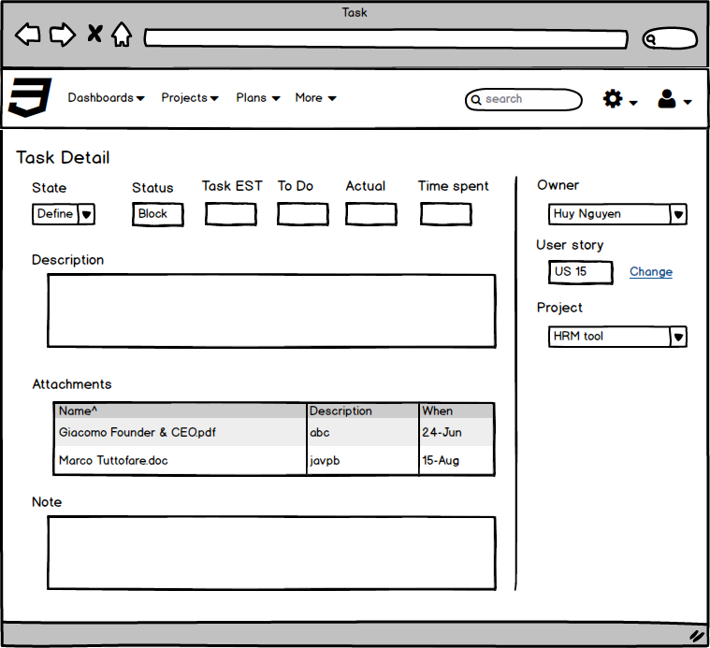
“Task Detail” screen

Slide 19
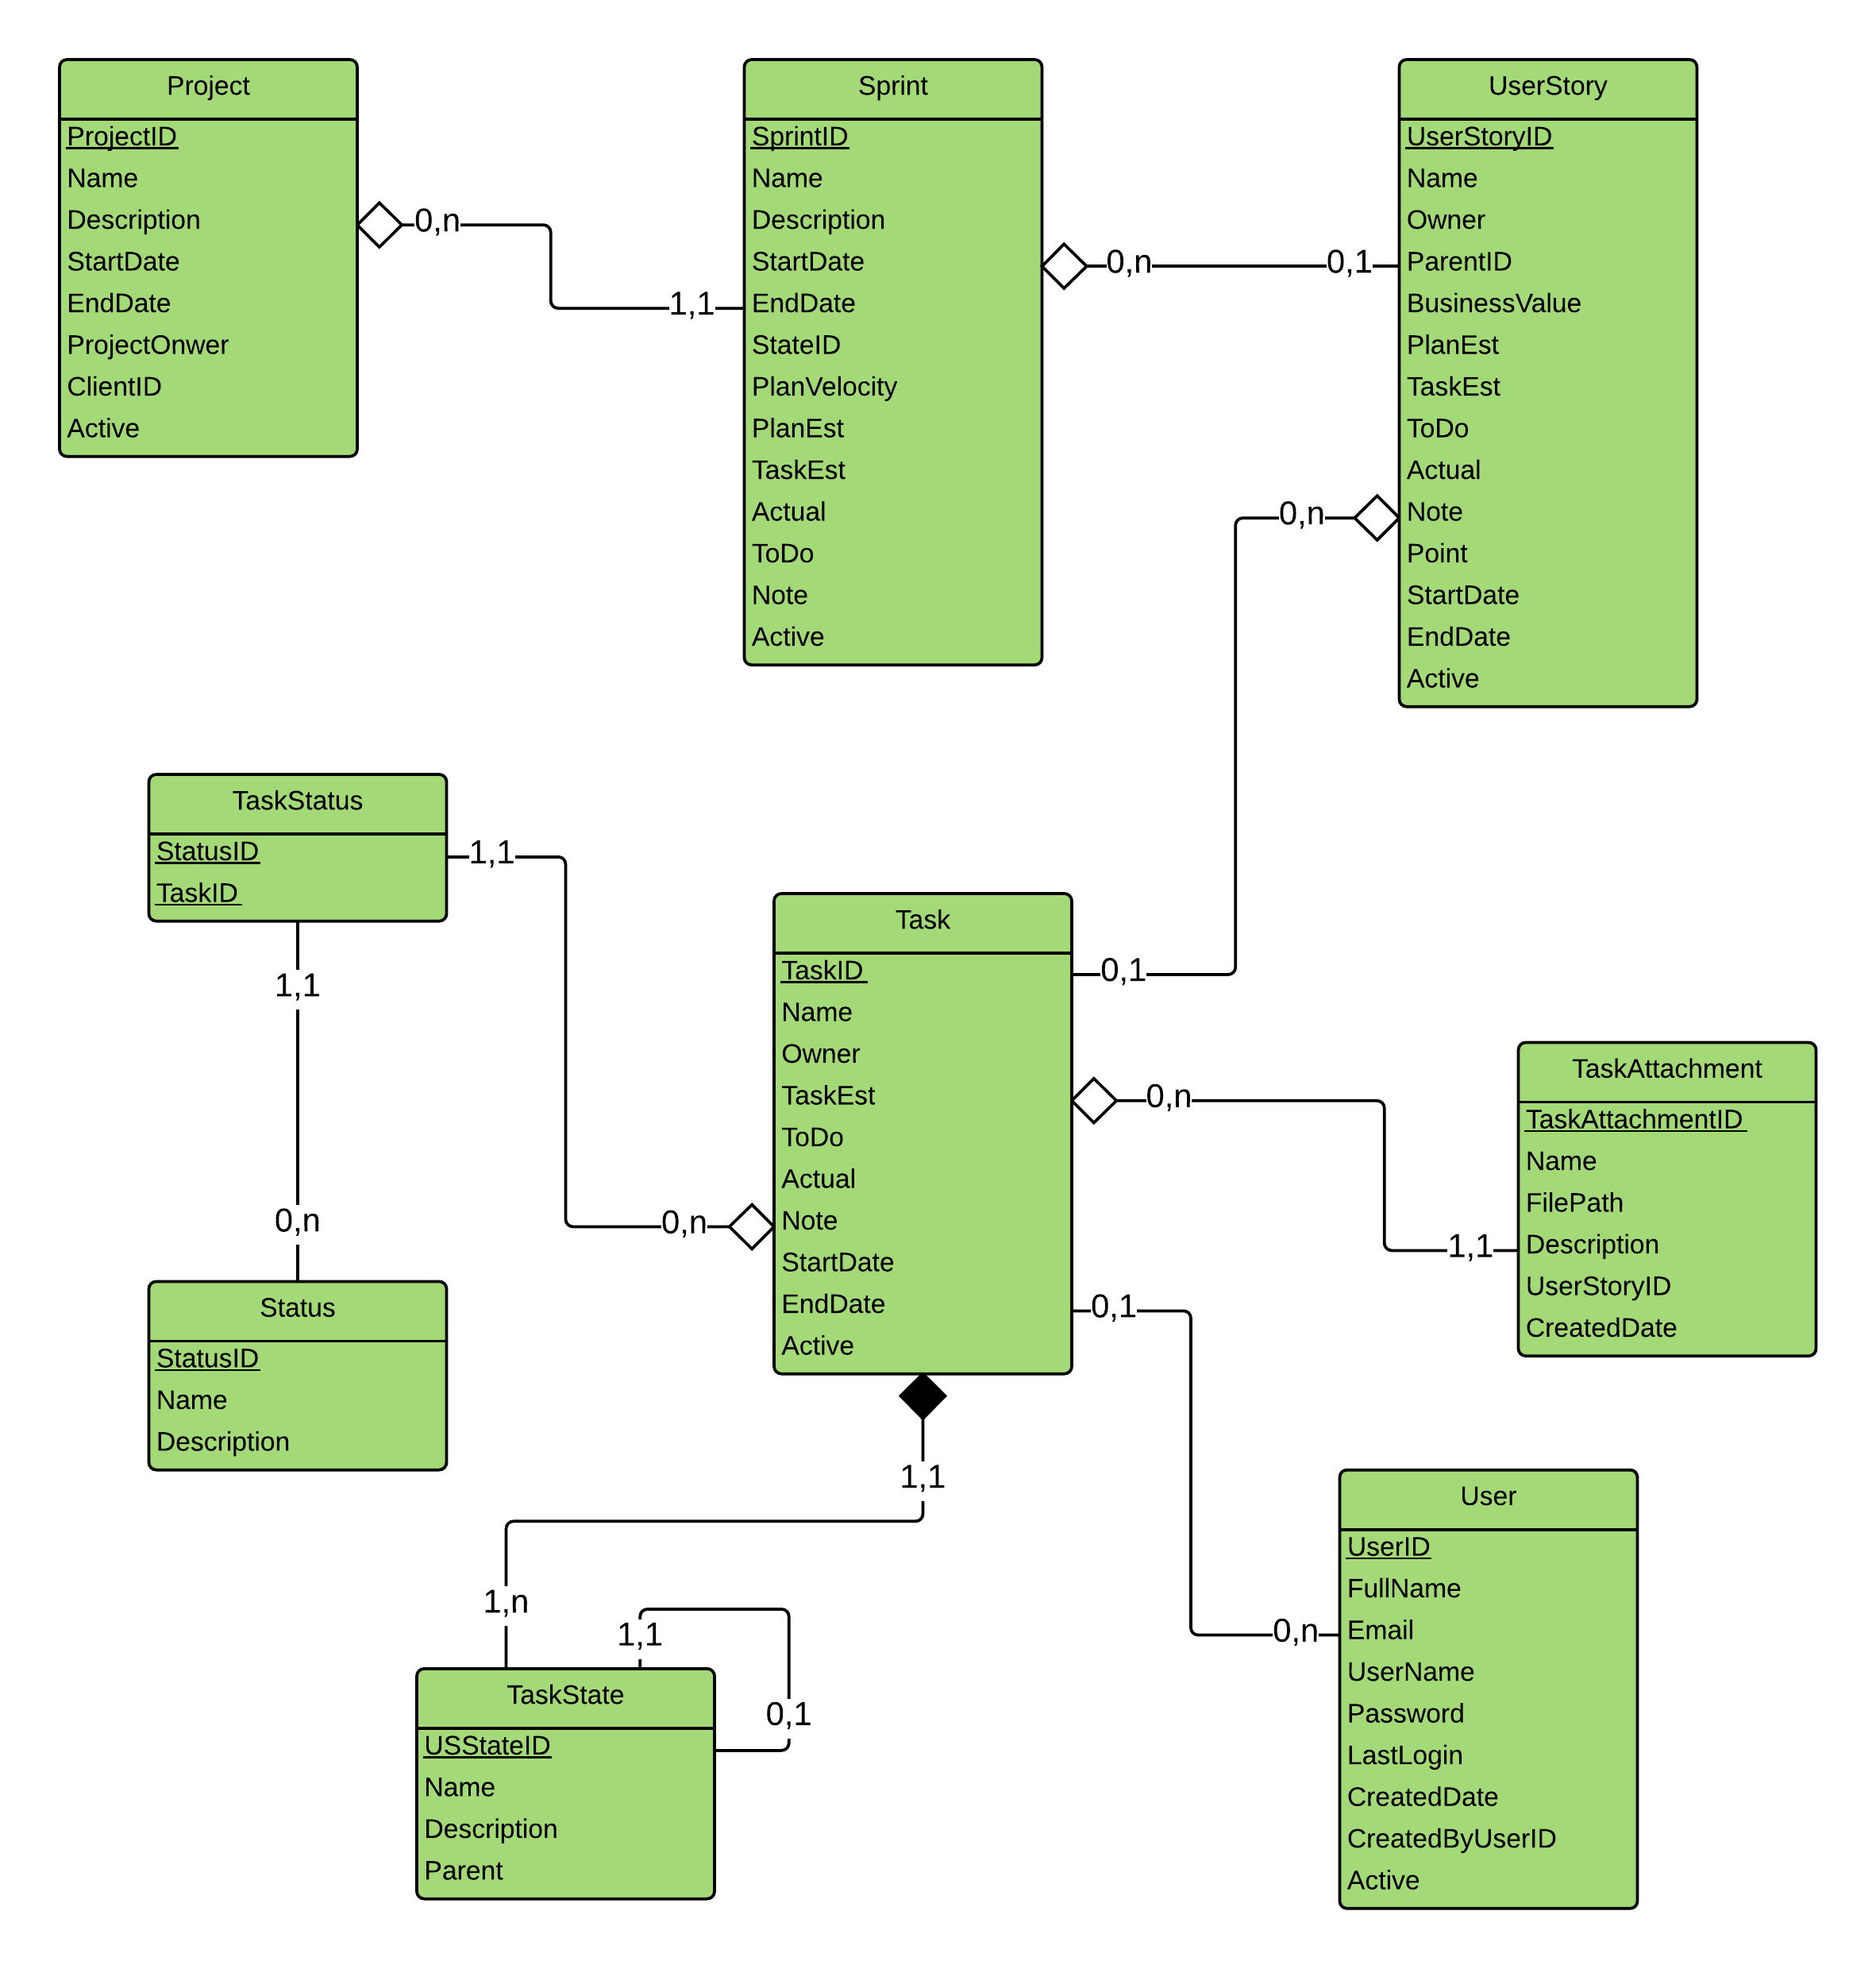
“Task Detail” screen

Slide 20
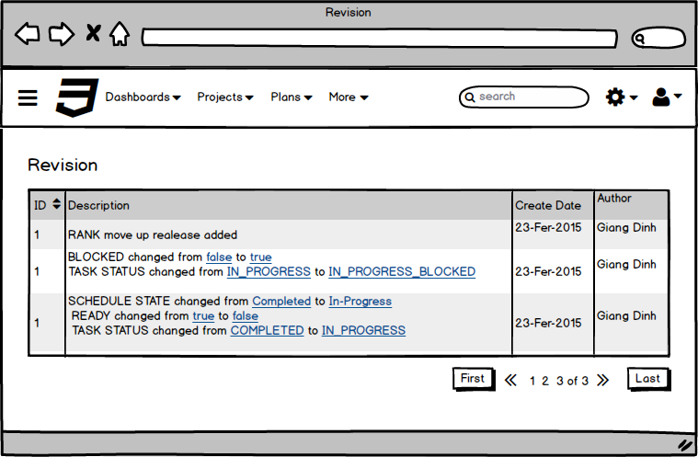
“Revision” screen (userstory or task)

Slide 21
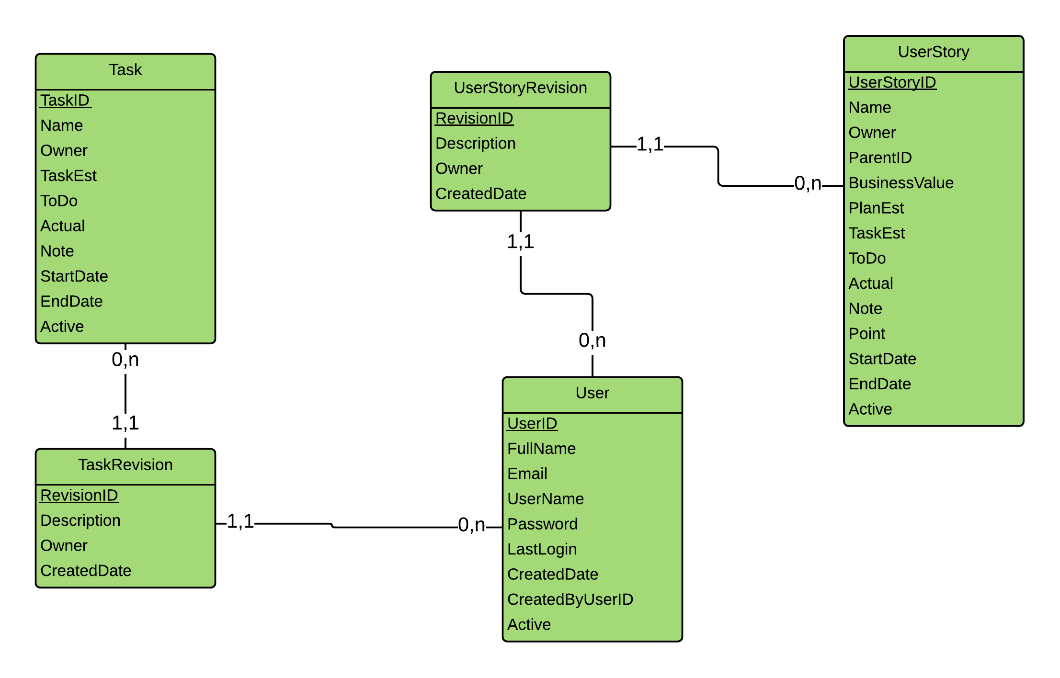
“Revision” screen

Slide 22
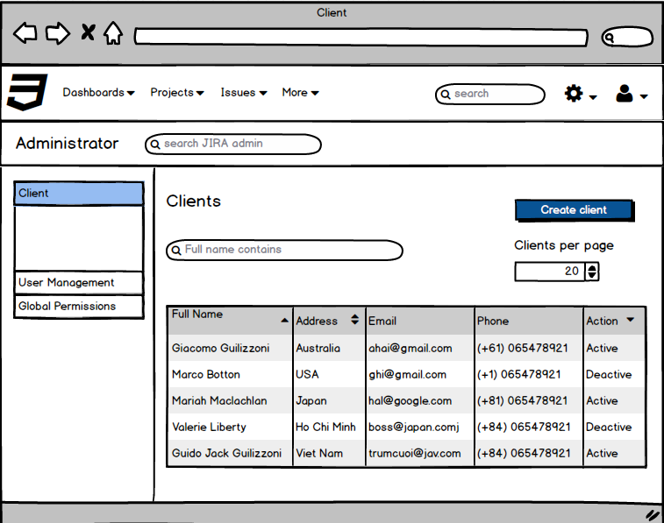
“Client List” screen

Slide 23
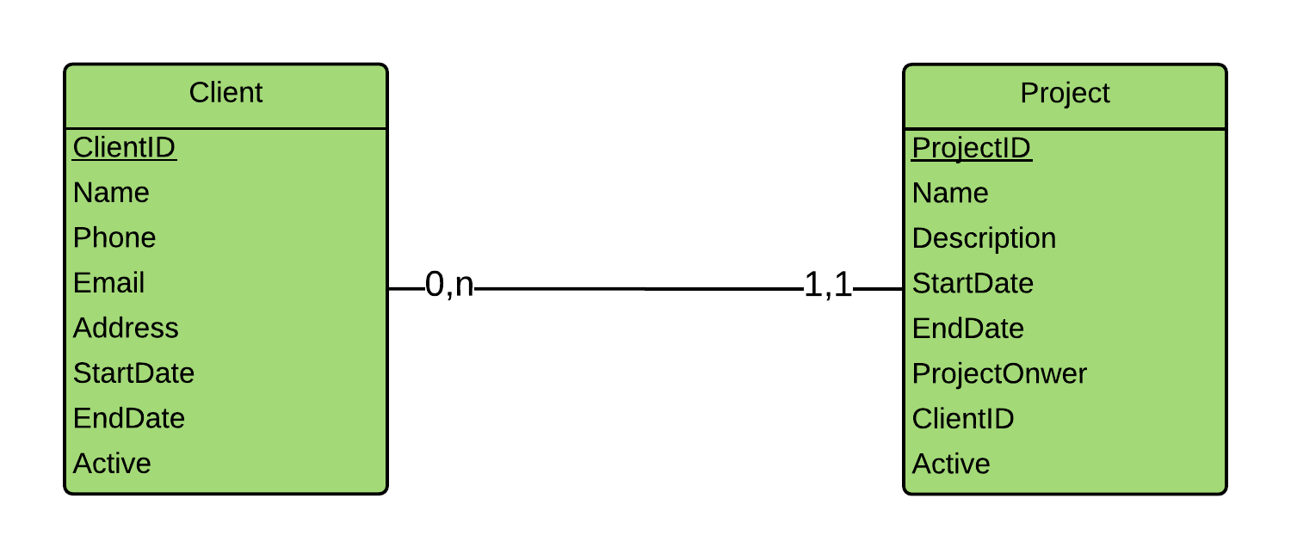
“Client List” screen

Slide 24
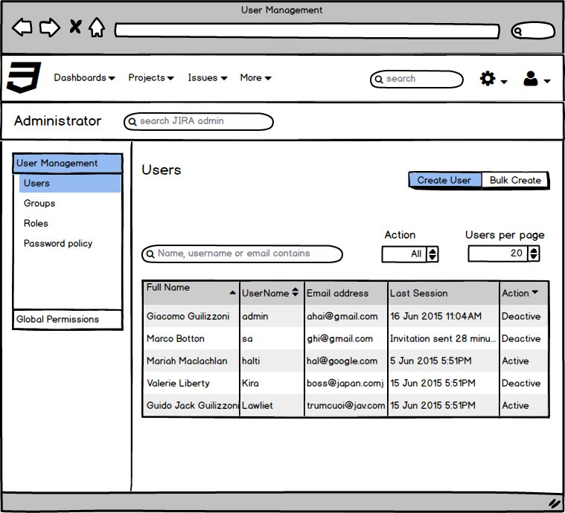
“User Management” screen

Slide 25
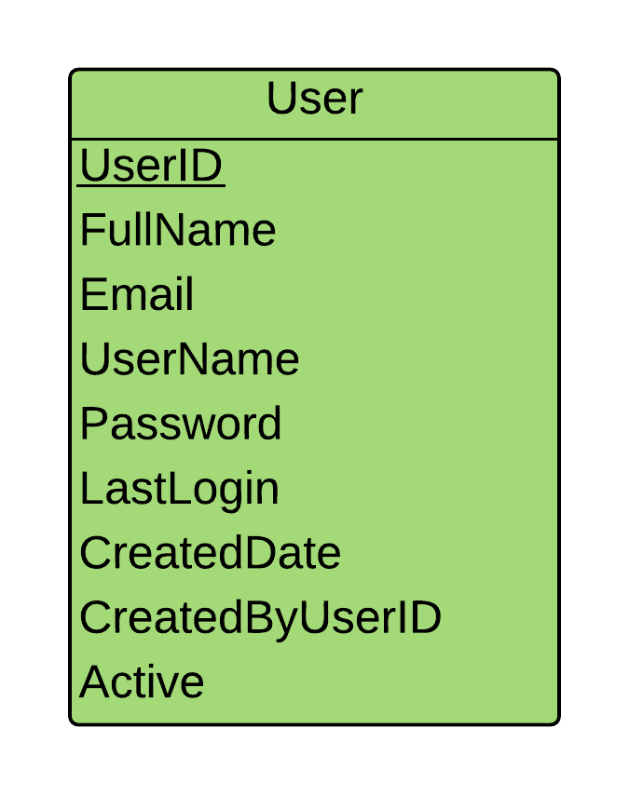
“User Management” screen

Slide 26
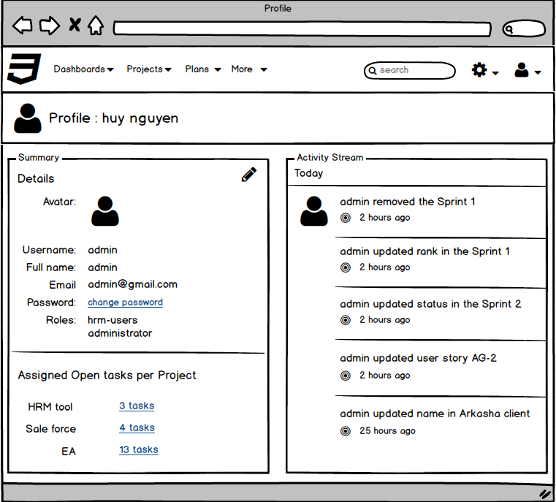
“User Profile” screen
Notes:
SWAT 2010

Slide 27
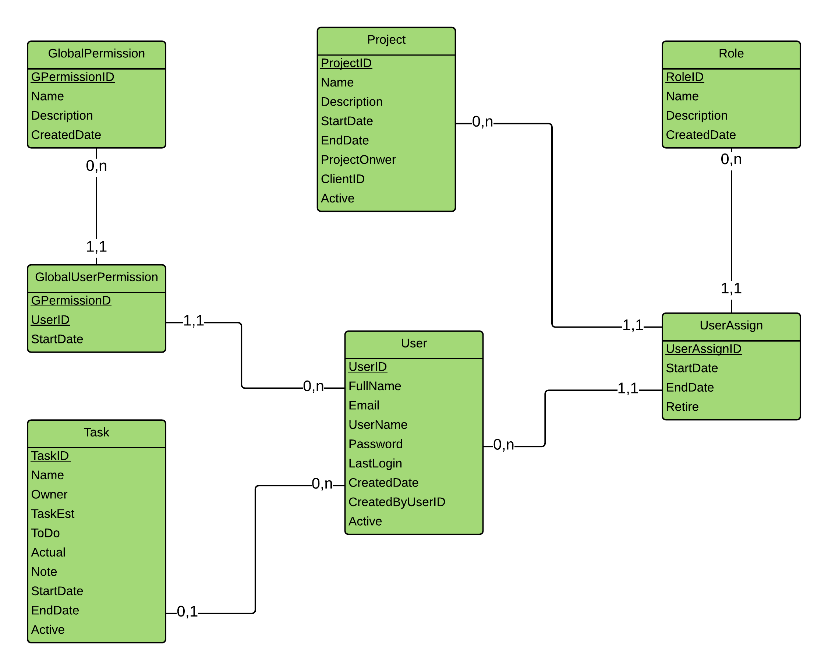
“User Profile” screen

Slide 28
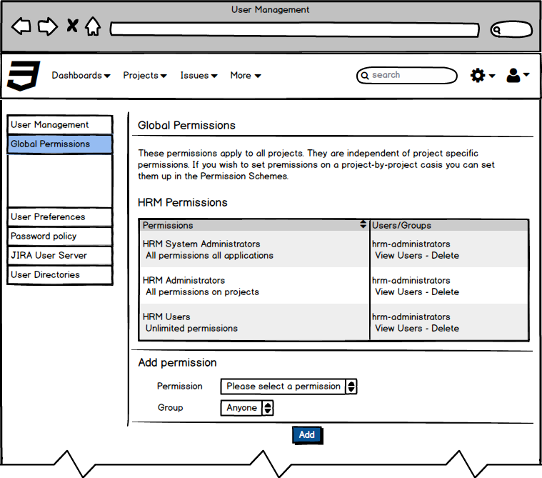
“Global Permission” screen

Slide 29
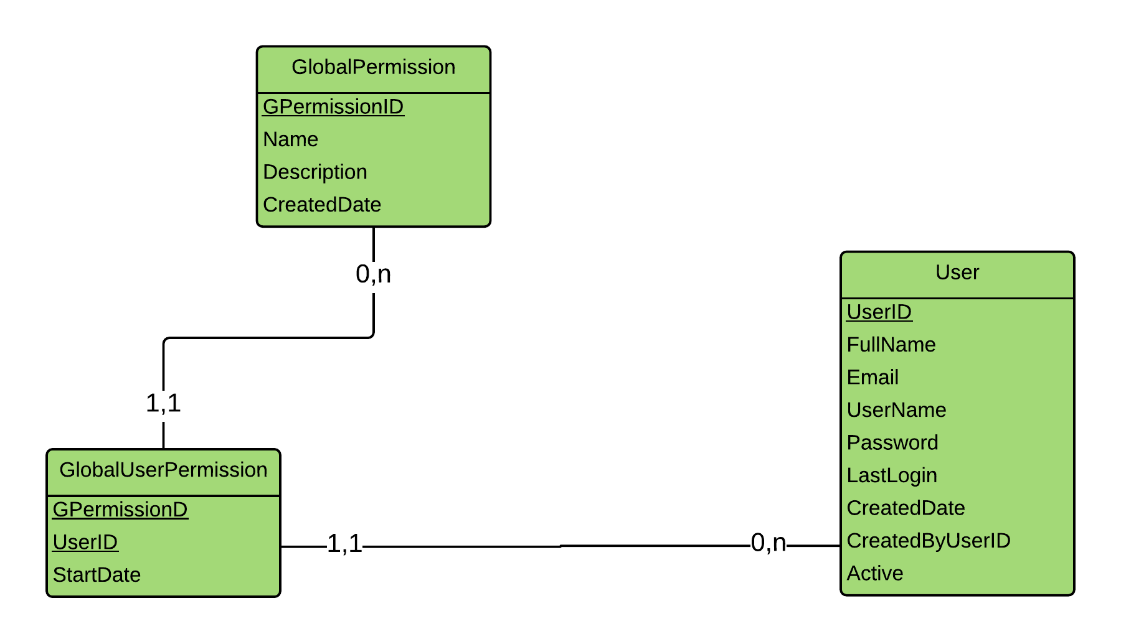
“Global Permission” screen

Slide 30
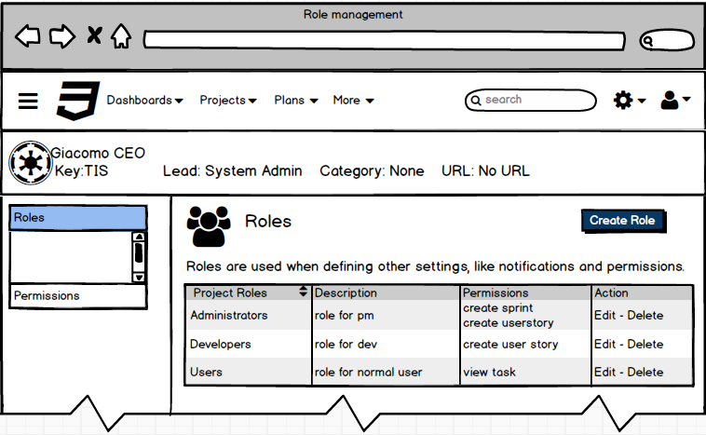
“Roles” screen

Slide 31
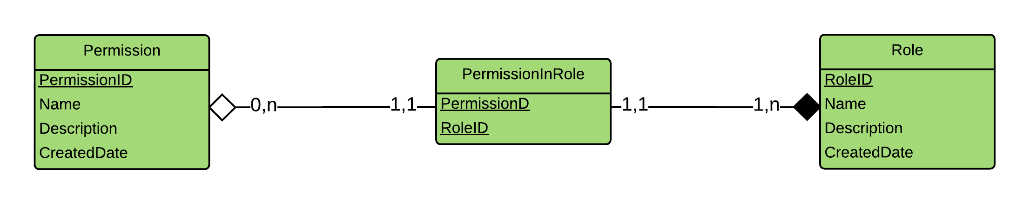
“Roles” screen

Slide 32
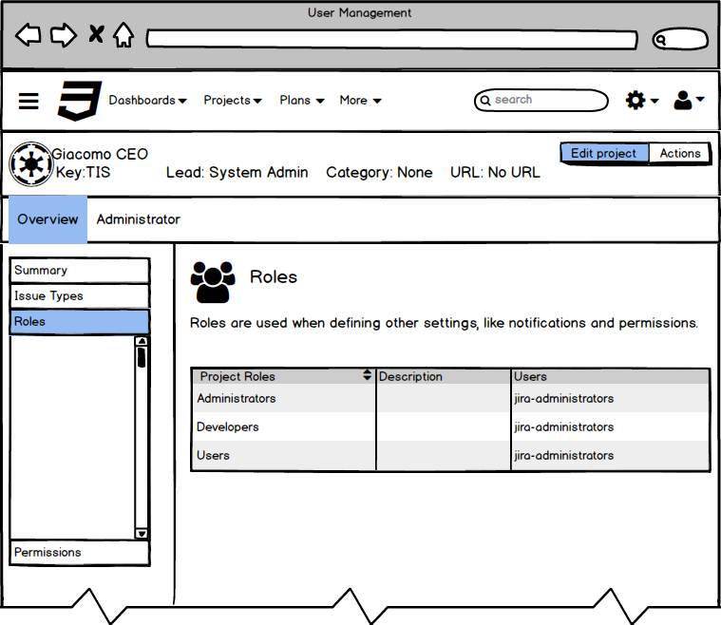
“Project Roles” screen

Slide 33
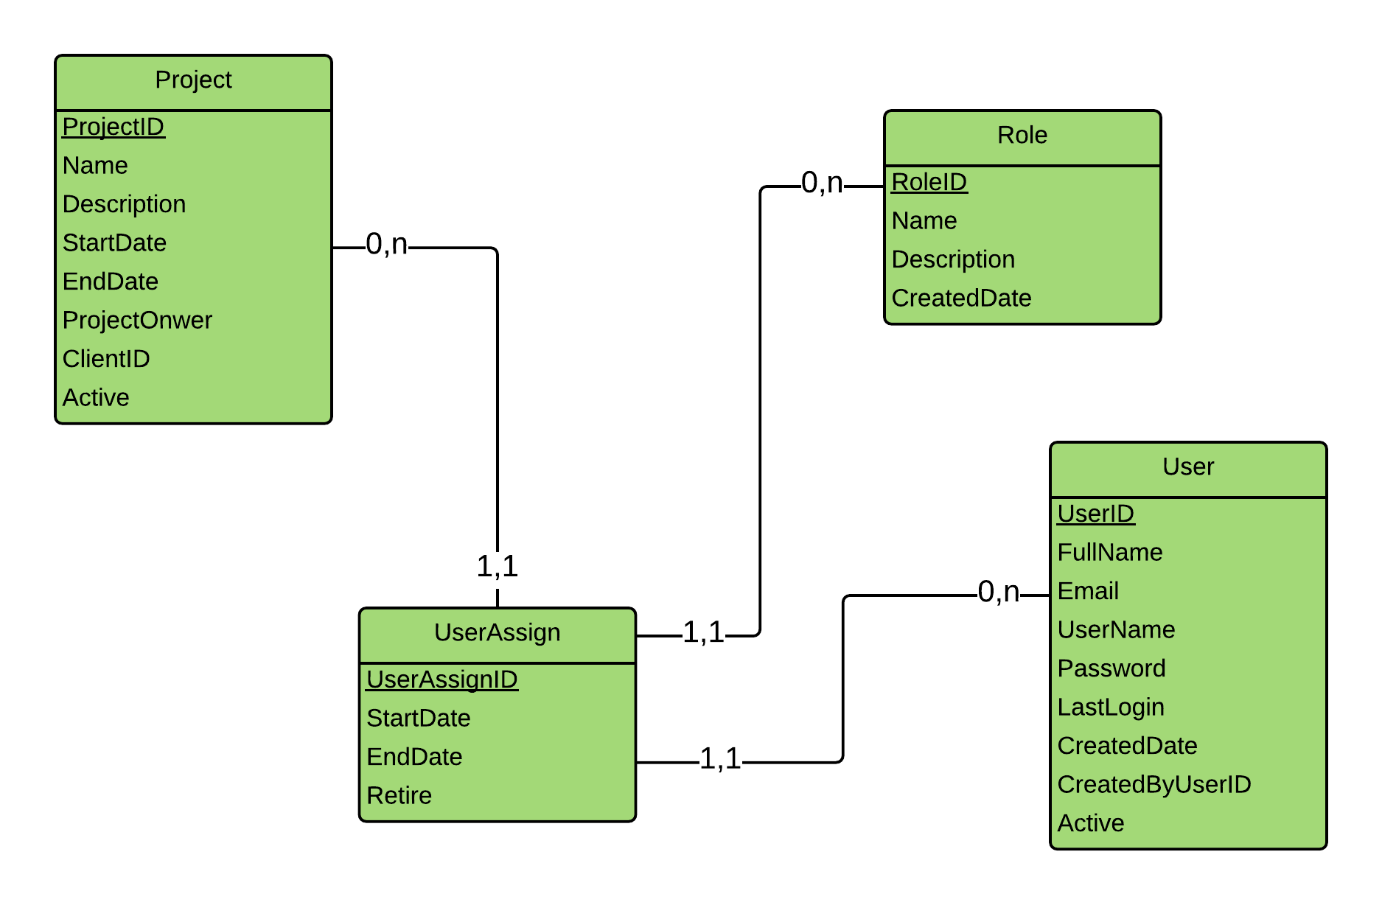
“Project Roles” screen

Slide 34
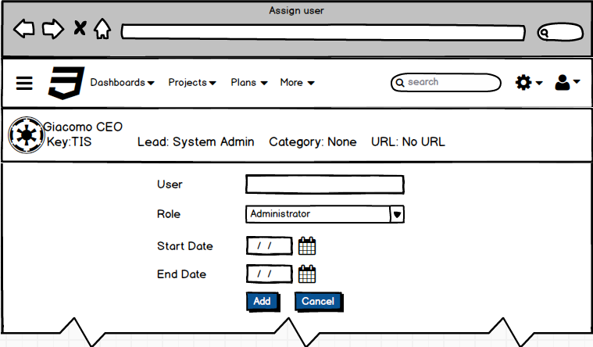
“Assign user” screen

Slide 35
“Assign user” screen

Slide 36
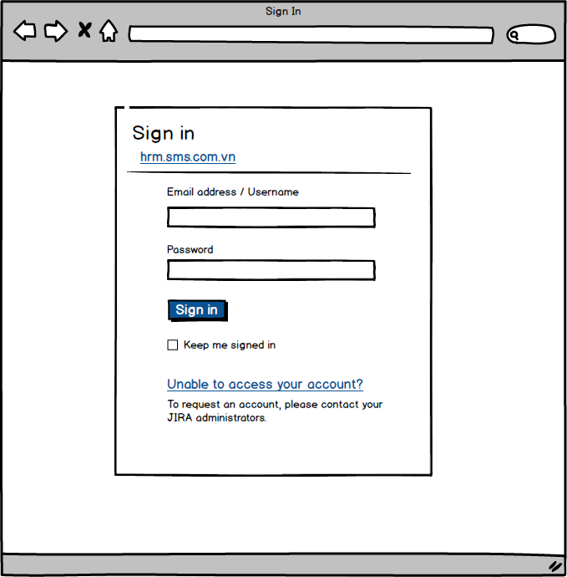
“Sign In” screen

Slide 37
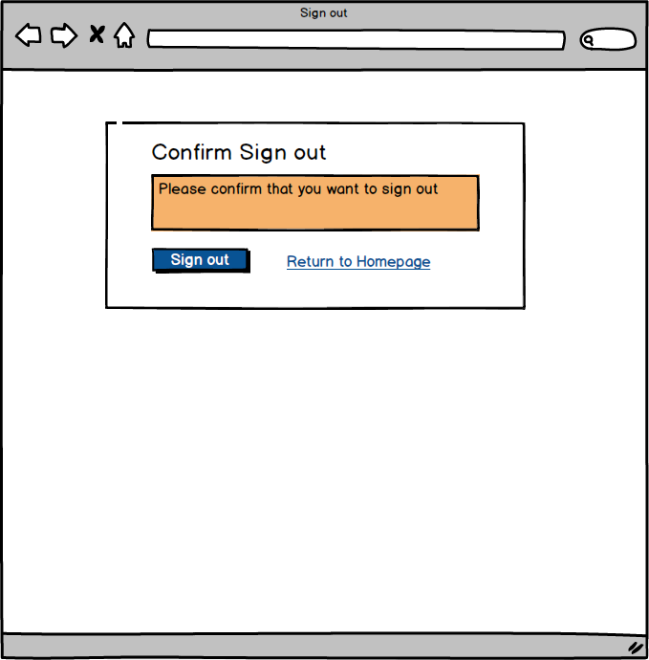
“Sign out” screen

Slide 38
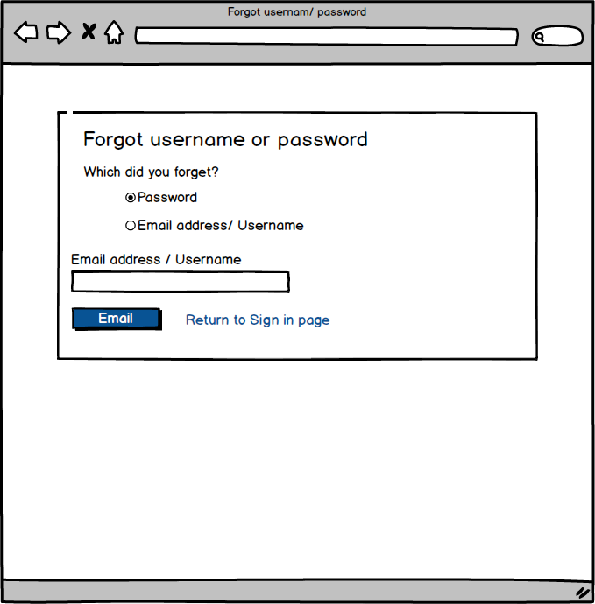
“Forgot username/password” screen

Slide 39
Create Database on MySQL - Demo
Create fields and tables in logical model
Create sql script (“hrm.sql” file in folder “sql script”)

Slide 40
Physical Model

Slide 41
Physical Model

Slide 42
Denormailize

Slide 43
Create Database on MySQL - Demo

Slide 44
Questions

